Slide 1


Software Services Platform and Search Tool
Carly Robinson Assistant Director for Information Products and Services
Department of Energy
Office of Scientific and Technical Information

Slide 2


DOE Invests $12B per Year in R&D
NATIONAL LABS
Ames
Argonne
Brookhaven
Fermi
Idaho
Los Alamos
Lawrence Berkeley
Lawrence Livermore
NETL
NREL
Oak Ridge
Pacific Northwest
Princeton
SLAC
Sandia
Savannah River
Thomas Jefferson
GRANTEES
TECHNOLOGY CENTERS
SITES
R&D Results
SCIENTIFIC & TECHNICAL INFO
Journal articles/accepted manuscripts
Technical reports
Conference papers
Theses/dissertations
Scientific and technical software
Data objects
Patents
Workshop reports
Videos
≈ 50,000 STI “products” per year
R&D Funding
Advanced Research Projects Agency – Energy (ARPA-E)
Office of Electricity Delivery & Energy Reliability
Office of Energy Efficiency & Renewable Energy
Office of Environmental Management
Office of Fossil Energy
Office of Legacy Management
Office of Nuclear Energy
Office of Science
Office of Environment, Health, Safety & Security

Slide 3
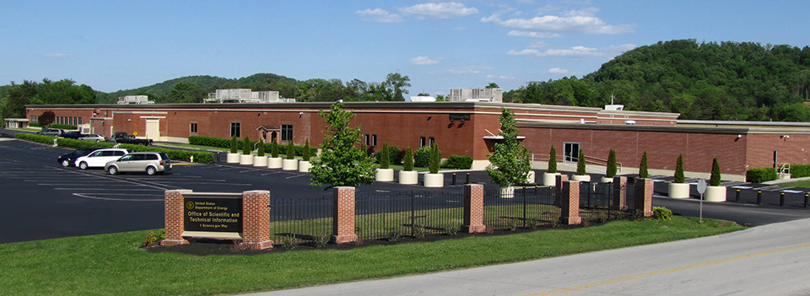
OSTI’s Role/Mission
The Office of Scientific and Technical Information (OSTI) collects, preserves, and disseminates DOE-funded research and development results.
Mission
Advance science and sustain technological creativity by making R&D findings available and useful to Department of Energy researchers and the public.
Core Functions
Collection
Preservation
Dissemination

Slide 4

Modernizing our Software Collection and Dissemination Model
Reinvented the Energy Science and Technology Software Center (ESTSC) was DOE’s software submission and dissemination tool.
Not comprehensive
Not modern
Using feedback from DOE researchers, developers, policy, legal, and technical communities – 9 requirements teams – the requirements for a reinvented ESTSC were defined.
Renamed DOE CODE (launched alpha Nov. 2017) – open source code and requirements posted to GitHub
DOE Code repository on GitHub
https://github.com/doecode/
DOE CODE – software services and search tool
https://www.osti.gov/doecode/

Slide 5

Modern Science and the Role of Software
Modern science is data-intensive and computer-dependent.
Software/Code is essential for creating, processing, analyzing, preserving, and re-using data – i.e. an integral component and result of modern science.
Modern software is increasingly open source – in private sector and, especially, in science.
Collaborative platforms have emerged to support open source software.
Social coding sites, such as GitHub and BitBucket
“Software Foundations,” e.g. Eclipse, Apache, Linux “foundations”
5

Slide 6
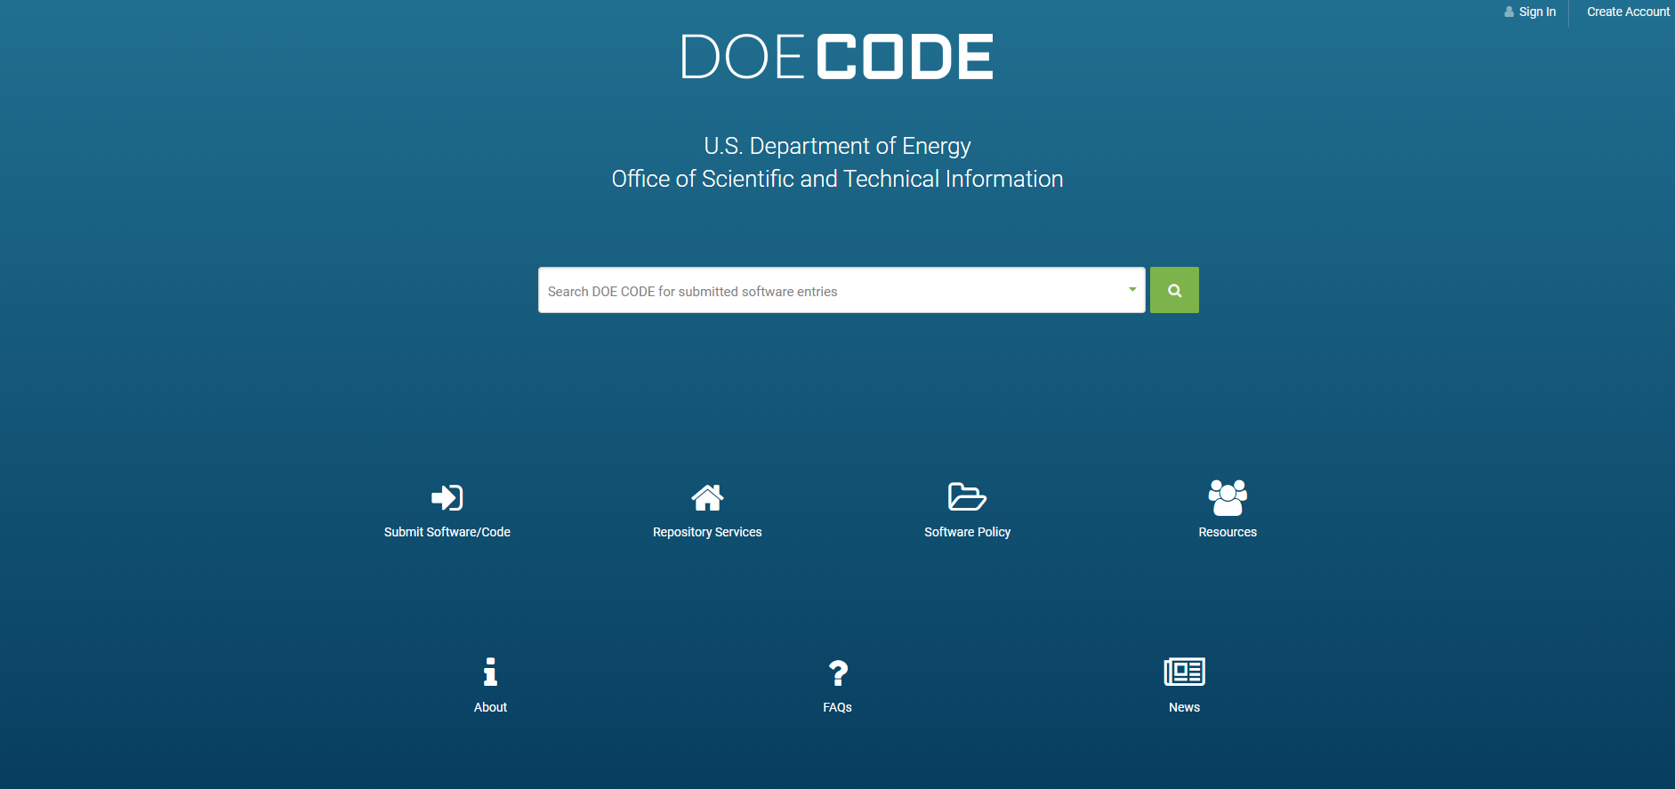

Slide 7






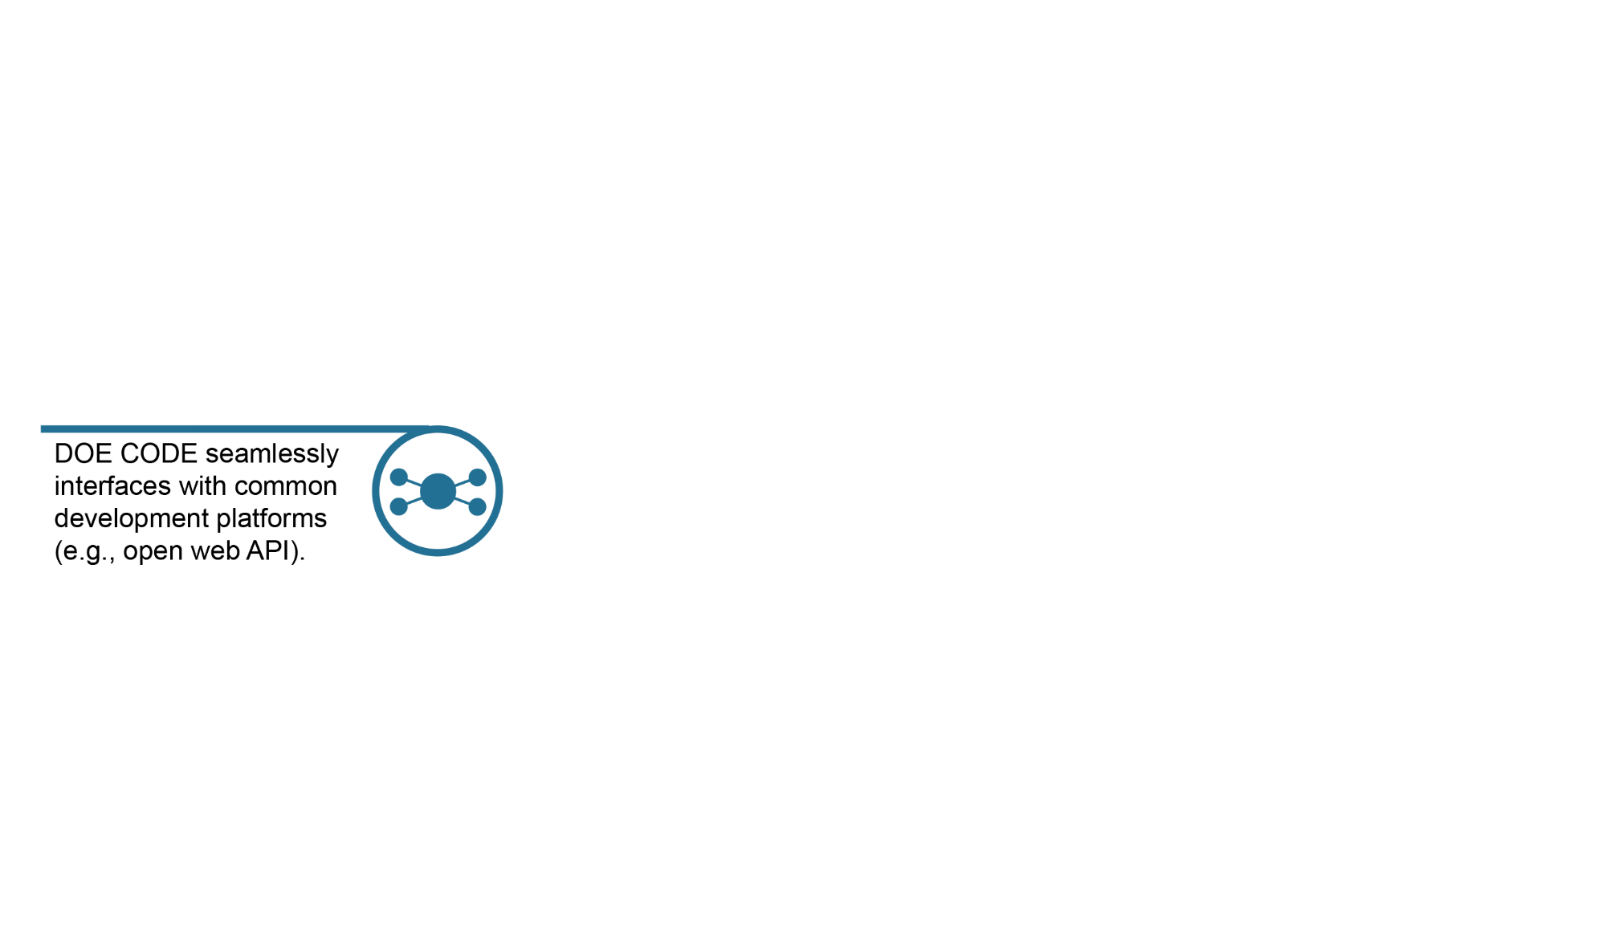
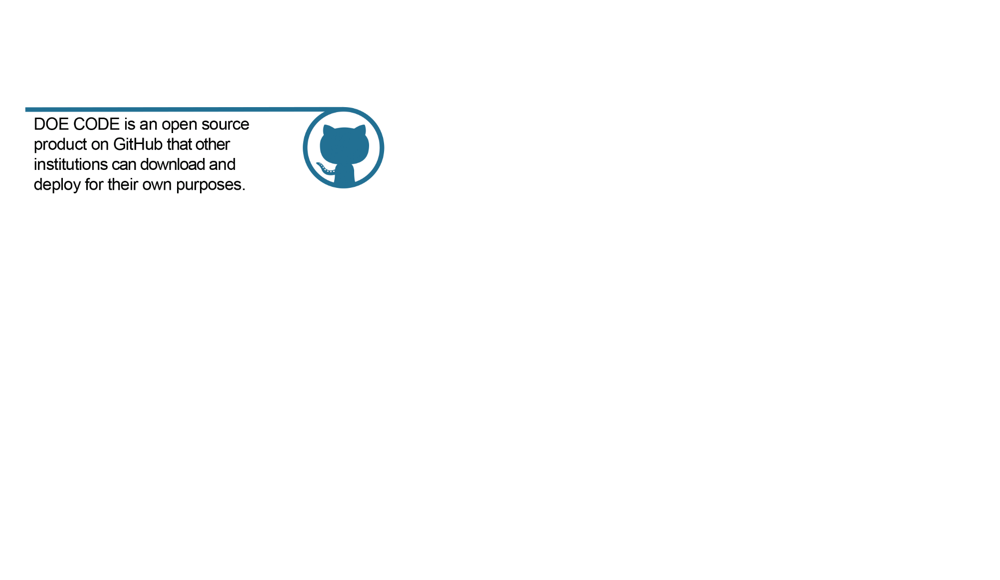
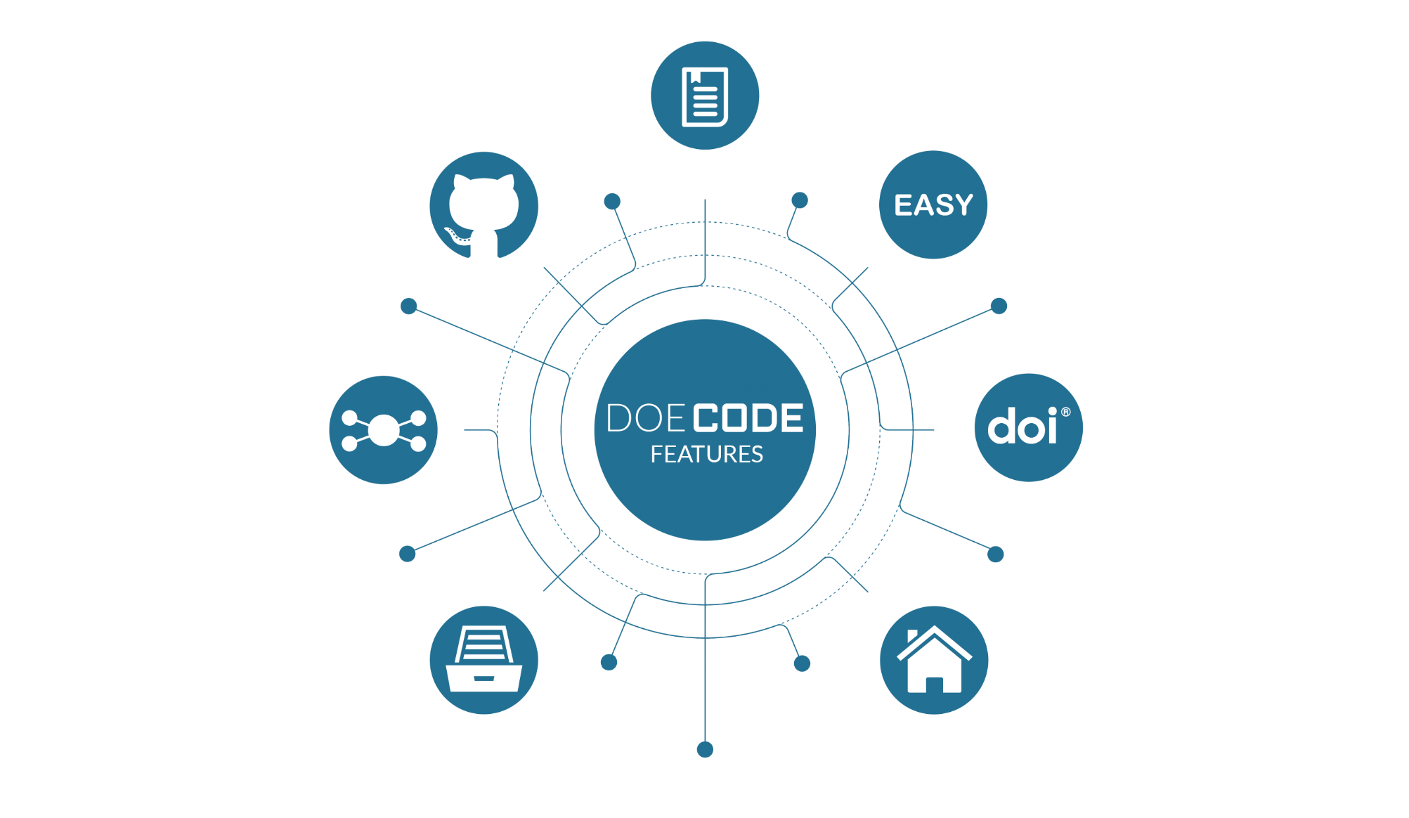

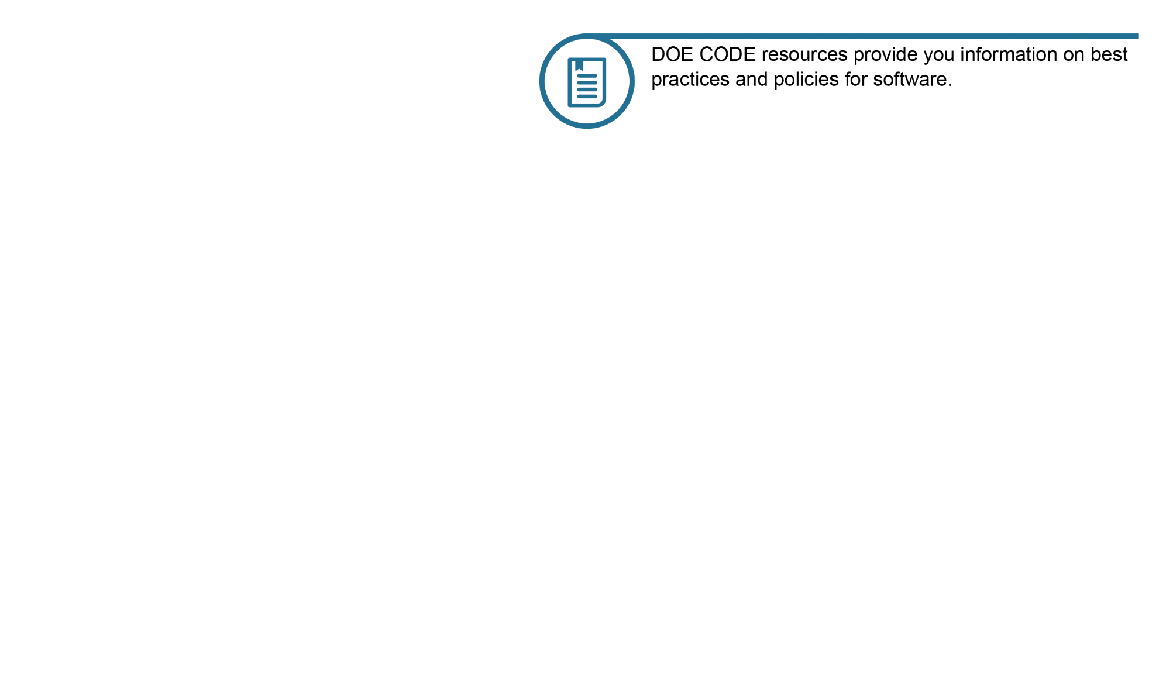

Slide 8

Submitting and Announcing Software to DOE
Submitting Software
minimal set of metadata required
option to obtain a Digital Object Identifier (DOI) for the code
codes in early development
Announcing Software
ensures announcement and dissemination in accordance with DOE statutory responsibilities
DOI assigned and registered
codes in later stages of development
DOE CODE is a software service platform and search tool that allows for scientific and business software to be provided to the U.S. Department of Energy (DOE). DOE CODE provides functionality for collaboration, archiving, and discovery of scientific and business software. DOE CODE replaces the Energy Science and Technology Software Center (ESTSC).
The DOE Office of Scientific and Technical Information (OSTI) is charged with fulfilling the Department's responsibilities to collect, preserve, and disseminate scientific and technical information, including software, emanating from DOE R&D activities.
In addition to OSTI's charge for scientific software, the Office of the Chief Information Officer (OCIO) and OSTI are partnering to leverage DOE CODE to maintain a comprehensive inventory of DOE-funded custom-developed business software. In accordance with Office of Management and Budget Memorandum M-16-21, Federal Source Code Policy: Achieving Efficiency, Transparency, and Innovation through Reusable and Open Source Software, DOE CODE will fulfill requirements to maintain an inventory of all DOE-funded custom-developed software and to report this inventory to the government-wide Code.gov website.
When providing software and code to DOE CODE, users will first need to identify what type of software they are submitting - scientific or business software. Users who are unsure of the type of software are encouraged to please work with their site's Dissemination Authority.

Slide 9
Submitting and Announcing Metadata
Submitting Software Required Metadata Fields
Project Type/Software Availability *
Repository Link *
Software Title *
Description/Abstract *
Licenses *
Developers * - Email, ORCID, Affiliations
DOI, Release Date
Announcing Software Required Metadata Fields
Project Type/Software Availability *
Repository Link *
Software Title *
Description/Abstract *
Licenses *
Developers * - ORCID, Email, Affiliations
Release Date *
Sponsoring Organization Name *, Primary Award Number *, Additional Awards, B&R Codes, FWP Numbers
Research Organization Name *
Short Title/Acronym
Country of Origin
Keywords
Other Special Requirements
Site Accession Number
Contributors, Email, ORCID, Affiliations, Contributor Type
Contributing Organization, Contributor Type
Related Identifiers
Contact Information
* = required fields

Slide 10
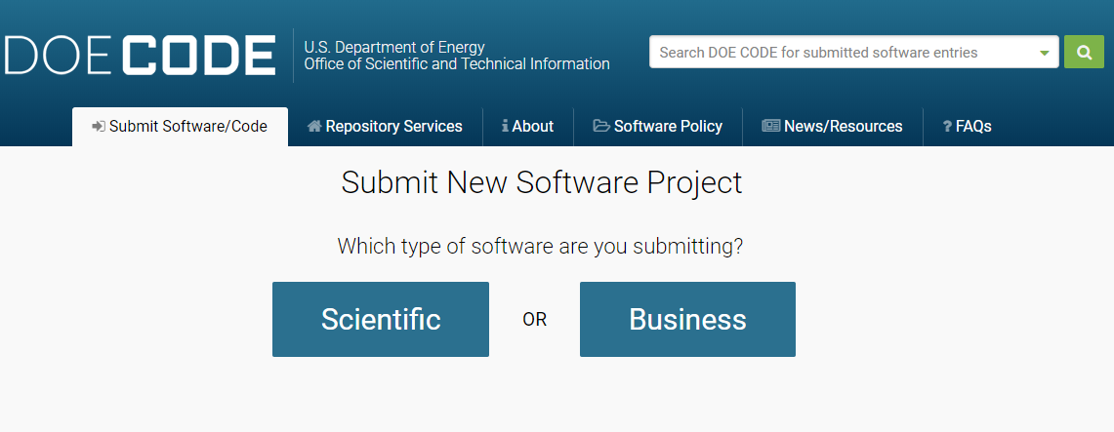
Submitting and Announcing Metadata

Slide 11
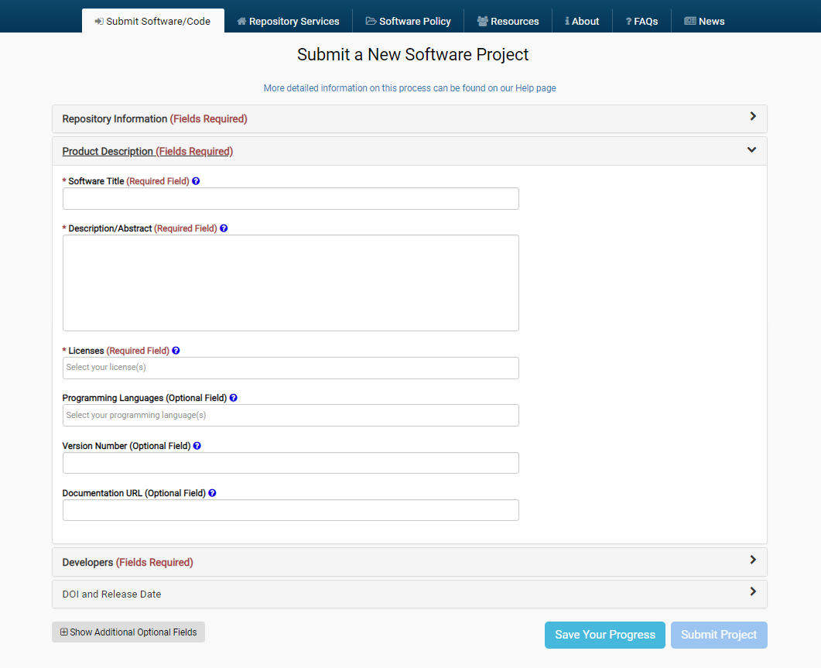

Slide 12
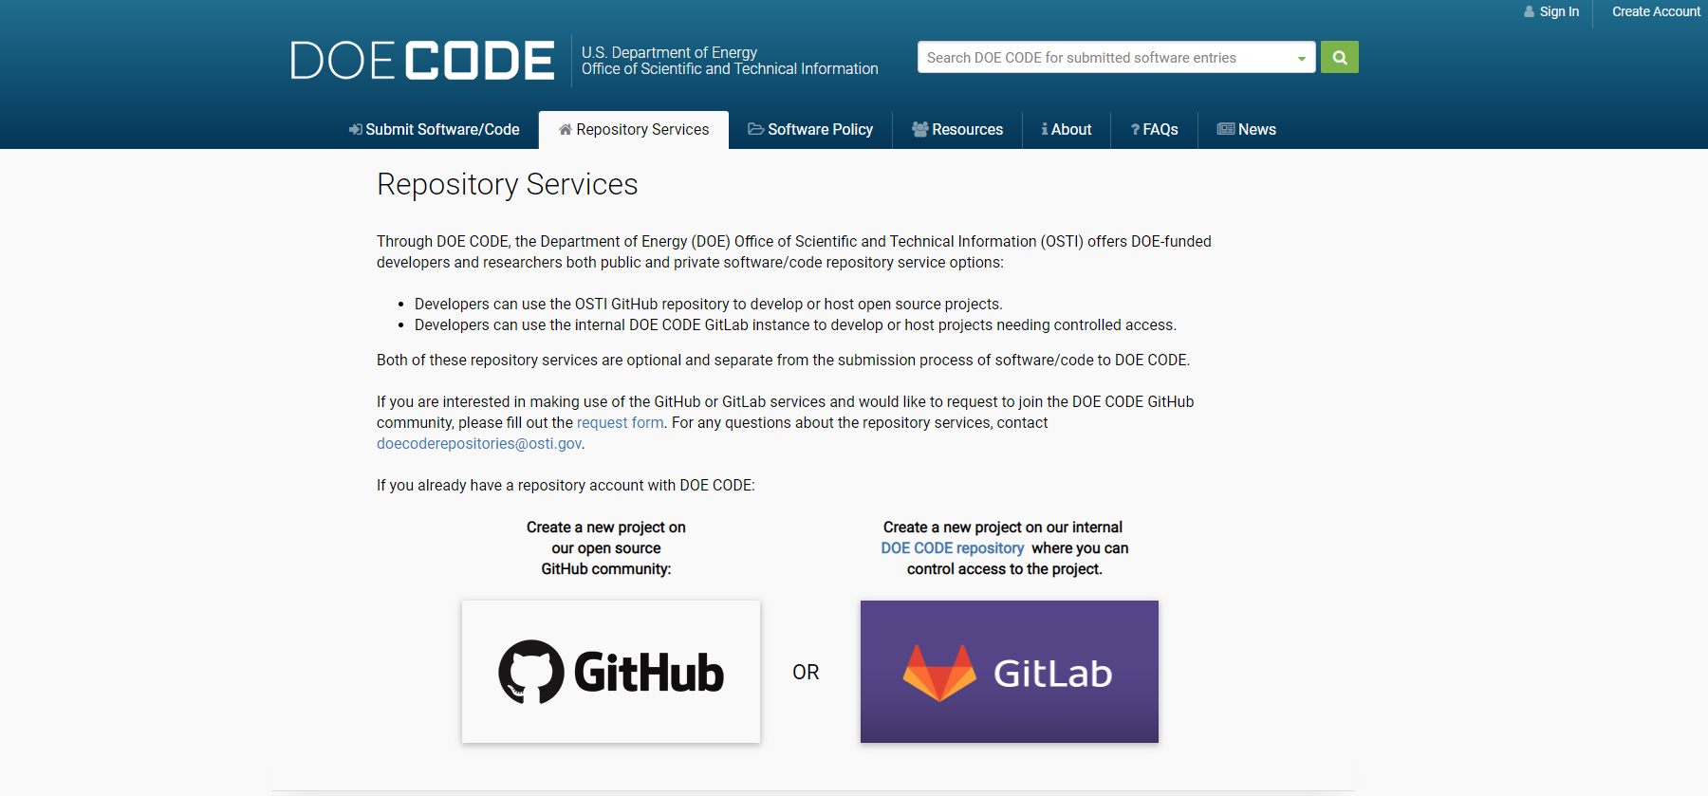

Slide 13
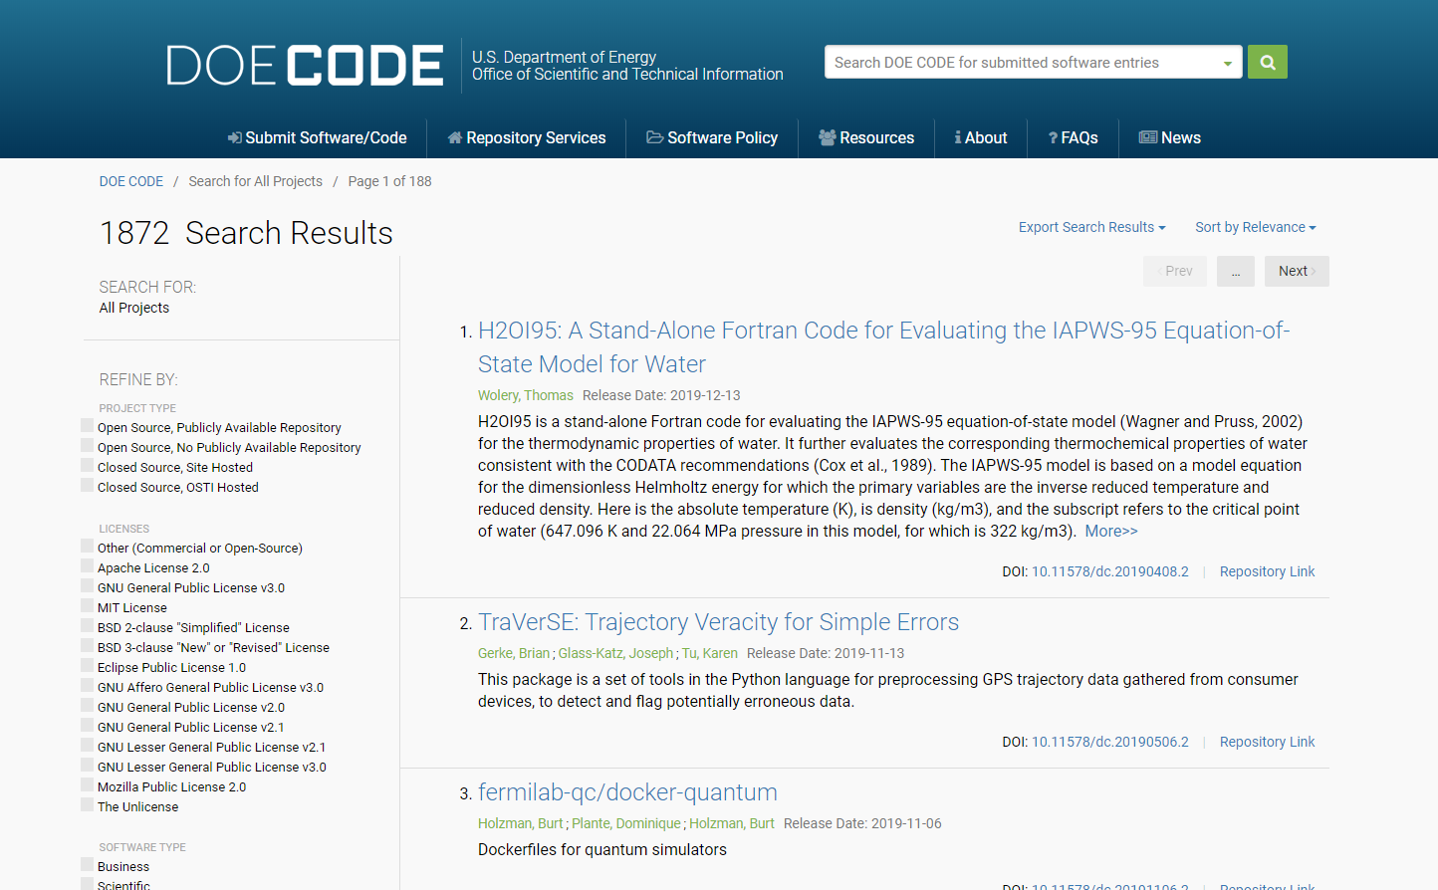

Slide 14
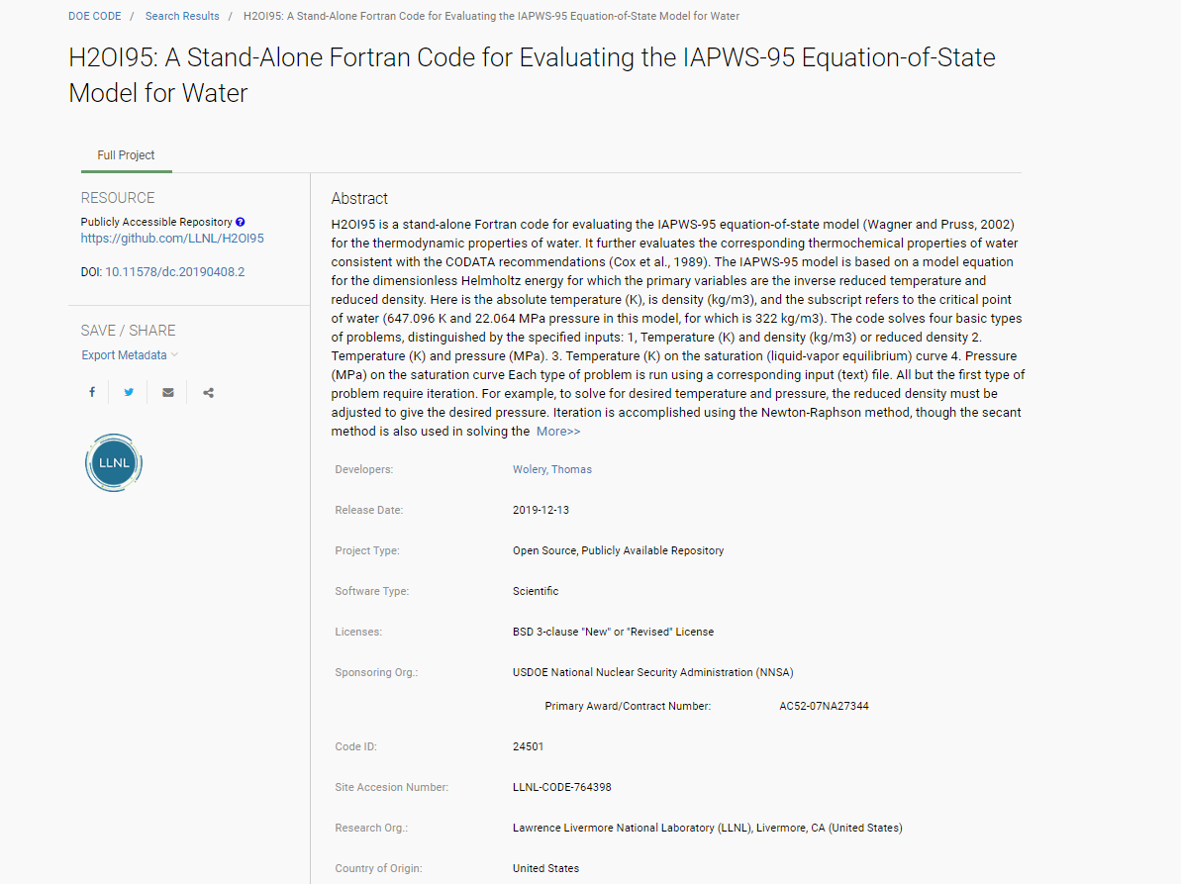

Slide 15
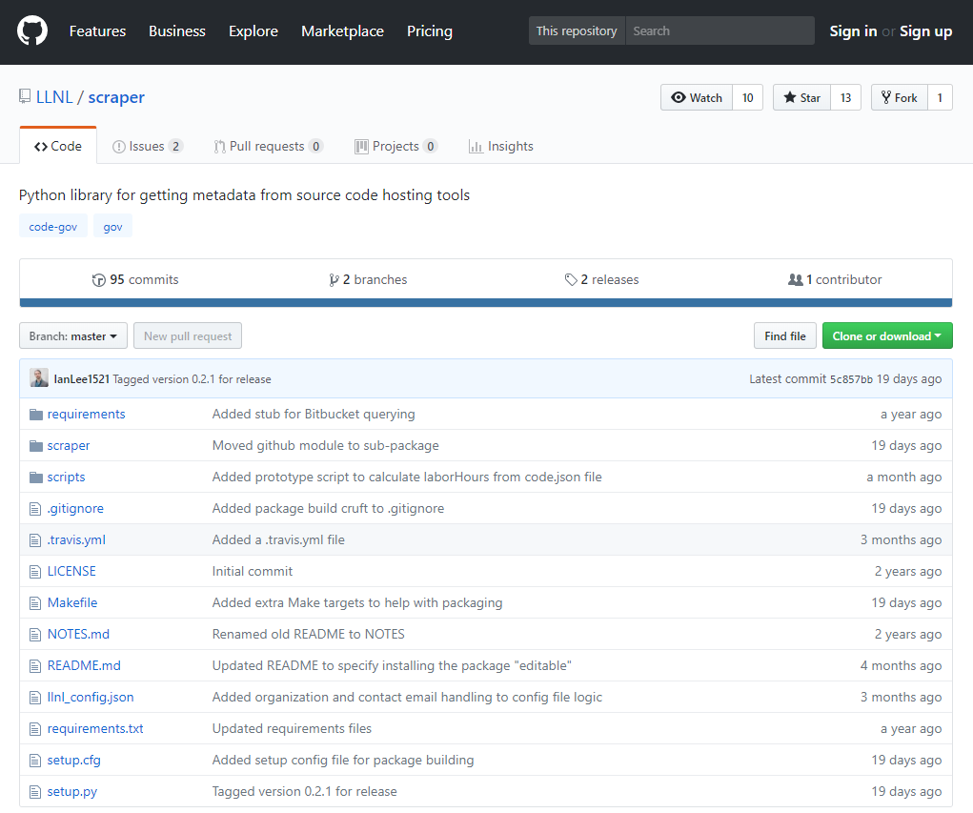
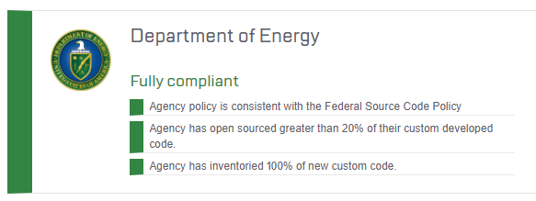
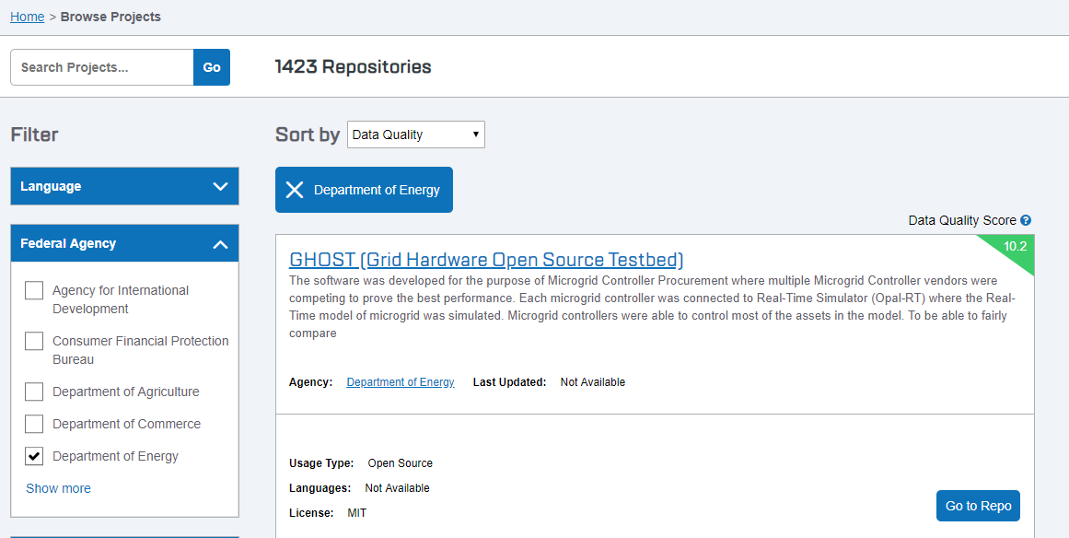


Slide 16
Questions?
Carly Robinson
Carly.Robinson@science.doe.gov
www.osti.gov
comments@osti.gov
@osti.gov

